Slide 1
Chapter 3
Branch, Call and Time Delay Loop

Slide 2
Objectives
Upon Completion, students will be able to:
Code HCS12 Assembly Language instructions to create loops
Code HCS12 Assembly Language conditional branch instructions
Explain conditions that determine each conditional branch instruction
Code instructions for unconditional jumps
Calculate target addresses for conditional branch instructions
Code HCS12 subroutines
Describe the use of stack calling subroutines
Discuss pipelining and instruction queue in the HCS12
Discuss relative and indexed addressing modes
Write a loop program using indexed addressing modes.

Slide 3
3.1 Branch Instructions and Looping
Looping in HCS12
Repeating an operation or sequence of operations a certain number of times
We could do it like this..
CLRA ; A = 0
ADDA #3 ; A = 3
ADDA #3 ; A = 6
ADDA #3 ; A = 9
ADDA #3 ; A = 0C H
ADDA #3 ; A = 0F H
Of course this is like swatting flies with a sledge hammer

Slide 4
Using instruction BNE for Looping
BNE stands for Branch if Not equal to 0
For example
LDAB #250 ; LOAD COUNTER VALUE
BACK …………….. ; START OF LOOP
…………….. ; BODY OF LOOP
DECB ;DECREMENT B,
BNE BACK ; BRANCH TO BACK IF B = 0 AND Z OF CCR = 1
; ELSE CONTINUE

Slide 5
Example using BNE
; This program adds value 3 decimal to Register A 10 times
COUNT EQU 10 ; 10 IS MAX VALUE OF COUNTER
LDAB #COUNT ; LOAD COUNT INTO B
CLRA ; A = 0
AGAIN ADDA #3 ; Start of loop adding 3 decimal each time
DECB ; Decrement B
BNE ; Repeat until counter = 0
STAA $200 ; STORE SUM INTO LOCATION 200 H

Slide 6
Flow Chart of Previous Example
ADD 3 TO A
DECREMENT COUNTER
=
0
?
NO
YES
STORE DATA

Slide 7
Using Ram for Counters
Example Program to add 3 to register A 15 times, using a RAM location to hold the counter and storing the result in RAM location $1250
;THIS PROGRAM ADDS VALUE 3 D TO A 15 TIMES
COUNT EQU $1225 ; USE LOC 1225 H FOR COUNTER
MYRAM EQU $1250 ; USE LOC 1250 H FOR RESULT
LDAA #15 ; LOAD 15 D INTO A
STAA COUNT ; LOAD THE COUNTER
CLRA ; A = 0
AGAIN ADDA #3 ; ADD 3 D TO A, START OF LOOP
DEC COUNT ; DECREMENT COUNTER
BNE AGAIN ; REPEAT UNTIL COUNT = 0
STAA MYRAM ; STORE RESULT 2D

Slide 8
Load Counter
Into loc $1225
Clear Reg A
Add value to A
Dec Counter
Count = 0?
no
yes
Store Sum

Slide 9
Limitation of previous example
Because Count is an 8 bit register:
Maximum of 255 times or FF loops
One way to overcome this is a nested loop
Note the next example

Slide 10
; This program initializes PORTB with value 55 H then complements it 700 times
R1 EQU $1225 ; R1 AT LOC 1225 H
R2 EQU $1226 ; R2 AT LOC 1226 H
COUNT1 EQU 10 ; INTIALYZE FIRST COUNTER
COUNT2 EQU 70 ; INITIALYZE SECOND COUNTER
LDAA #$FF ; PRELIMINARY FOR NEXT STEP
STAA PORTB ; MAKES PORTB AN OUTPUT, WE’LL LEARN NEXT CHAP
LDAA #$55 ; A = 55H
STAA PORTB ; PORT B = 55 H
LDAA COUNT1 ; OUTER LOOP COUNT VALUE STORED IN A
STAA R1 ; OUTER LOOP VALUE INTO R1
OLOOP LDAA #COUNT2; LOAD INNER LOOP COUNT VALUE INTO A
STAA R2 ; LOAD VALUE 70 D INTO R2
ILOOP COM PORTB ; COMPLEMENT PORT B
DEC R2 ; DECREMENT INNER LOOP COUNTER
BNE ILOOP ; LOOP IF INNER COUNTER NE 0
DEC R1 ; DECREMENTS OUTER LOOP COUNTER
BNE OLOOP ; LOOP IS COMPLETED 10 TIMES WHEN OUTER COUNTER = 0

Slide 11
LOAD A
STORE IN PORTB
LOAD A
LOAD COUNTER 1
LOAD A
END
LOAD COUNTER 2
YES
COUNT 1 = 0?
TOGGLE PORTB
NO
DECREMENT COUNTER 2
COUNT 2 = 0?
NO
DECREMENT COUNTER 1
YES

Slide 12
; This program provides and example of how to loop 100,000 times complementing PORTB
; each time
R1 EQU $1201 ; RAM LOCATION FOR R1
R2 EQU $1202 ; RAM LOCATION FOR R2
R3 EQU $1203 ; RAM LOCATION FOR R3
COUNT1 EQU 100 ; VALUE FOR FIRST COUNTER = 100 D
COUNT2 EQU 100 ; VALUE FOR SECOND COUNTER = 100 D
COUNT3 EQU 10 ; VALUE FOR THIRD COUNTER = 100 D
LDAA #$FF ; PREPARATION FOR NEXT STEP
STAA DDRB ; MAKE PORTB AN OUTPUT
LDAA #$55 ; PREPARATION FOR NEXT STEP
STAA PORTB ; LOADS PORT B 55 H
LDAA #COUNT3 ; GET VALUE OF COUNTER 3
STAA R3 ; VALUE OF COUNTER THREE STORED AT $1203
LOOP3 LDAA #COUNT2; GET VALUE OF COUNTER 2
STAA R2 ; VALUE OF COUNTER TWO STORED AT $1202
LOOP2 LDAA #COUNT1; GET VALUE OF COUNTER ONE
STAA R1 ; VALUE OF COUNTER 1 STORED AT $1201
LOOP1 COM PORTB ; ONES COMPLEMENT PORTB
DEC R1 ; DECREMENT COUNTER 1
BNE LOOP1 ; REPEATS LOOP 100 TIMES
DEC R2 ; DECREMENT COUNTER 2
BNE LOOP2 ; REPEATS LOOP 100 TIMES
DEC R3 ; DECREMENTS COUNTER 3
BNE LOOP3 ; REPEATS LOOP 10 TIMES

Slide 13
; A simpler way to skin the cat
R1 EQU $1201 ; ASSIGN ADDRESS FOR COUNTER VARIABLES
R2 EQU $1202
R3 EQU $1203
COUNT1 EQU 100 ; INITIALYZE DECIMAL COUNTER VALUES
COUNT2 EQU 100
COUNT3 EQU 10
MOVB #$FF,DDRB ; MAKES PORTB AN OUTPUT
MOVB #$FF,PORTB ; LOADS 55 H INTO PORTB
MOVB #COUNT3,R3 ; LOADS 10 D INTO LOC $1203
LOOP3 MOVB #COUNT2,R2 ; LOADS 100 D INTO LOC $1202
LOOP2 MOVB #COUNT1,R1 ; LOADS 100 D INTO LOC $1201
LOOP1 COM PORTB ; COMPLEMENT PORTB
DEC R1 ; DECREMENTS FIRST COUNTER
BNE LOOP1 ; LOOPS 100 TIMES
DEC R2 ; DECREMENT SECOND COUNTER
BNE LOOP2 ; LOOPS 100 TIMES
DEC R3 ; DECREMENT THIRD COUNTER
BNE LOOP3 ; LOOPS 10 TIMES

Slide 14
Other Conditional Jumps
Instruction | Action
BCS | BRANCH IF C = 1
BCC | BRANCH IF C = 0
BEQ | BRANCH IF Z = 1
BNE | BRANCH IF Z = 0
BMI | BRANCH IF N = 1
BPL | BRANCH IFN = 0
BVS | BRANCH IF V = 1
BVC | BRANCH IF V = 0

Slide 15
; Example program to determine if a particular address contains a value of zero, and if so write
; a known value into it
MYLOC EQU $830 ; OUR PARTICULAR ADDRESS
LDAA MYLOC ; LOAD THE VALUE AT $830 INTO ACCUMULATOR
BNE NEXT ; BRANCH TO NEXT IF A NE 0
LDAA #$55 ; LOAD 55 H IF A IS ZERO
STAA MYLOC ; PUTS 55 H INTO LOCATION $830
NEXT …… ; OTHER CODE SEGMENT
; THIS IS A WAY TO BRANCH OVER A FOLLOWING CODE SEGMENT

Slide 16
; program to find the sum of 3 values and place the sum in two locations, low and high
; byte, big endian convention
LBYTE EQU $807
HBYTE EQU $806
CLRA ; JUST GOOD PRACTICE
STAA HBYTE ; HIGH BYTE = 0
ADDA #$79 ; ADD FIRST NUMBER
BCC N1 ; BRANCH IF C = 0
INC HBYTE ; WE ARE HERE BECAUSE C NE 0
N1 ADDA #$F5 ; $79 + $F5 = 16E AND C BIT BECOMES 1
BCC N2 ; BRANCH IF C = 0
INC HBYTE ; WE ARE HERE BECAUSE C IS NE 0
N2 ADDA #$E2 ; 16E + E2 = 250
BCC OVER ; BRANCH IF C = 0
INC HBYTE ; WE ARE HERE IF C NE 0
OVER STAA LBYTE ; LBYTE IS $50 AND HBYTE IS $2

Slide 17
Short Conditional Branches
Target must be within 128 bytes of the contents of PC
These are 2 byte instructions
First byte is opcode
Second byte is relative address to PC
Value of second byte may be between -127 and +128
Jump forward on positive, backwards on negative
Target address is sum of second byte and PC of next instruction

Slide 18
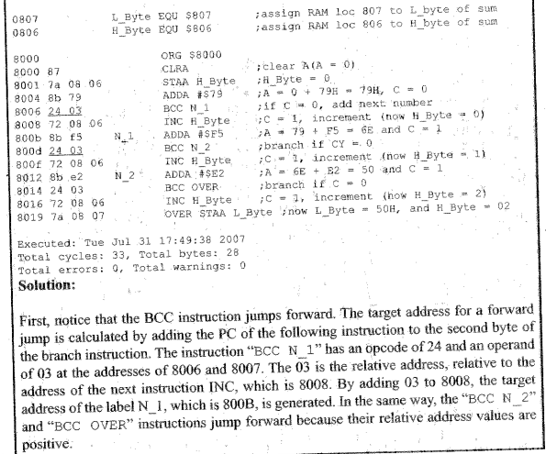
Verifying Jump Forward Address Using List File

Slide 19
Long Conditional Branches
Target must be within 32K bytes of PC
Instruction | Action
LBCS | Long Branch if C = 1
LBCC | Long Branch if C = 0
LBEQ | Long Branch if Z = 1
LBNE | Long Branch if Z = 0
LBMI | Long Branch if N = 1
LBPL | Long Branch if N = 0
LBVS | Long Branch if V = 1
LBVC | Long Branch if V = 0

Slide 20
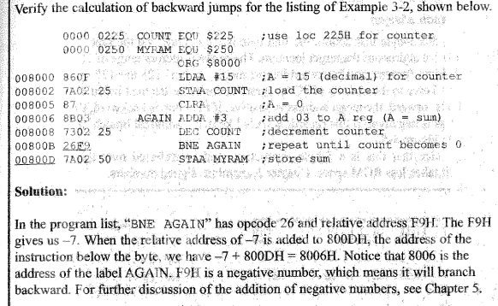

Slide 21
Unconditional Branch Instruction
Two commands
JMP – Jump
3 byte instruction
First byte is opcode
Second and third bytes are address
Address range is 0000 FFFF H
BRA – Branch
Two byte instruction
First byte is opcode
Second byte is address
Address range is -128 to +127 bytes from PC of next instruction
Takes less ROM space than JMP

Slide 22
Branching Using the $ Sign
HERE JMP HERE ; EQUIVALENT TO
JMP $
; AND
HERE BRA HERE ; EQUIVALENT TO
BRA $

